Slide 1

BANK LOAN CASE STUDY
JAY PANDYA

Slide 2
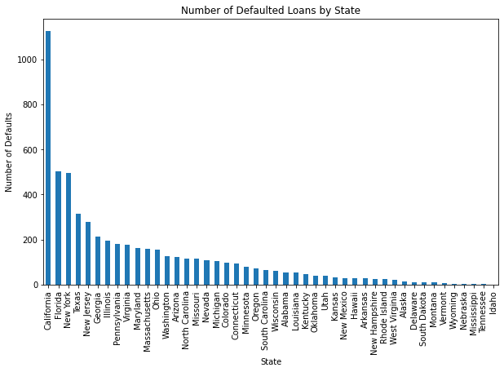
1-Loan Default Rate by State
In the case study, it was conclusively demonstrated that California exhibited the highest loan default rate among all states, while Idaho had notably lower default rates. This divergence in default rates signifies a critical disparity in the creditworthiness and financial stability of borrowers in these two states, warranting further investigation and potential policy considerations.

Slide 3
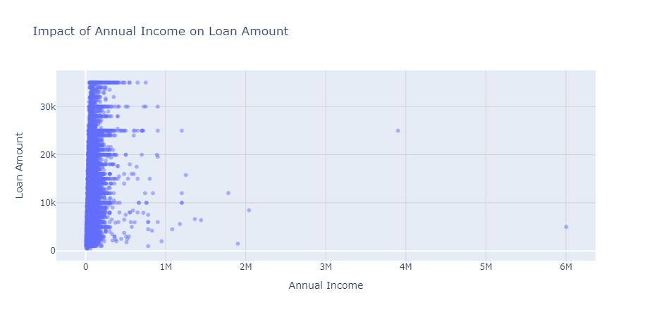
2.Impact of Annual Income on Loan Amount:
The conclusion drawn from the analysis is that annual income does not significantly influence the loan amount granted. This suggests that lending decisions may be driven by other factors such as credit history, employment status, or debt-to-income ratios, underscoring the importance of these aspects in loan approval processes.

Slide 4
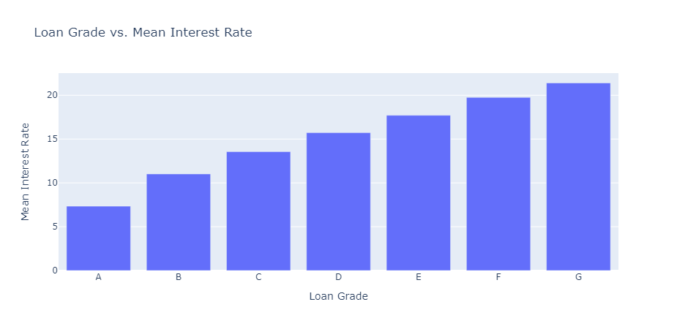
3. Loan Grade Analysis
In the study's conclusion, it was evident that loan grades significantly influenced interest rates. Loans with high grades, such as "A," featured lower interest rates, while those with low grades, like "G," carried substantially higher interest rates. This correlation underscores the pivotal role that loan grading plays in determining the cost of borrowing.

Slide 5
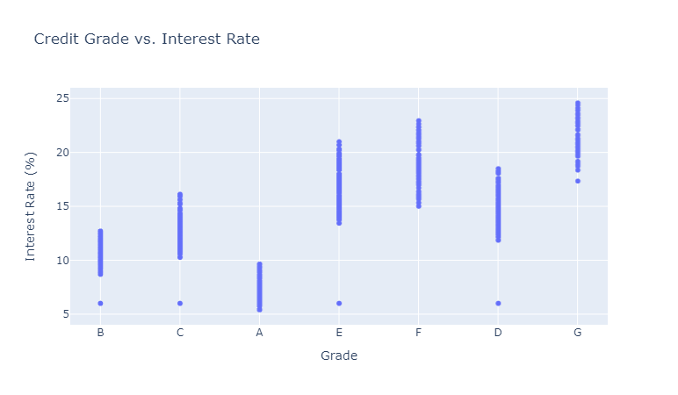
4.Credit Grade vs. Interest Rate
The study's conclusion revealed a significant correlation between credit grade and interest rates. Borrowers with higher credit grades, such as "A," enjoyed lower interest rates, indicating lower perceived risk by lenders. Conversely, those with lower credit grades, like "G," faced higher interest rates, reflecting the increased risk associated with lending to individuals with weaker credit profiles.

Slide 6
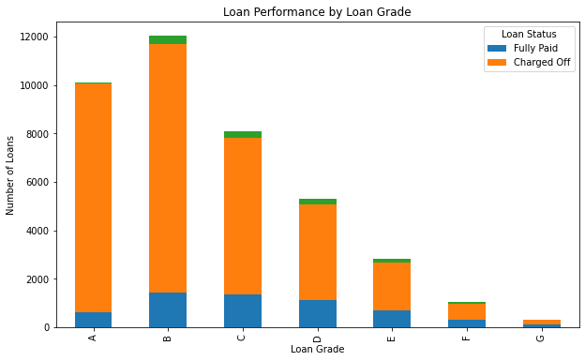
5.Loan Performance by Loan Grade
The analysis of loan performance by grade revealed a clear trend: loans with higher grades exhibited a higher incidence of default. Conversely, loans with lower grades had a considerably lower rate of default. This pattern underscores the importance of credit risk assessment in loan origination and suggests that lenders should consider refining their grading criteria to mitigate default risk.

Slide 7
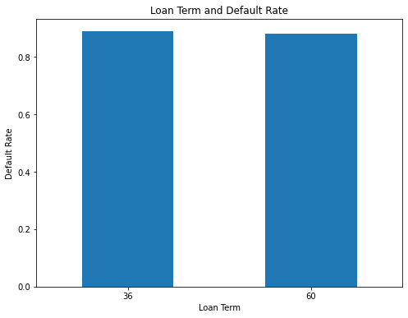
6.Loan Term and Default Rate:
it became evident that the loan term, whether short or long, did not significantly influence the default rate. Remarkably, both short and long-term loans exhibited a similar default rate. This suggests that other factors, such as borrower creditworthiness or economic conditions, may play a more substantial role in determining loan default rates. Further analysis is essential to understand the underlying causes.

Slide 8
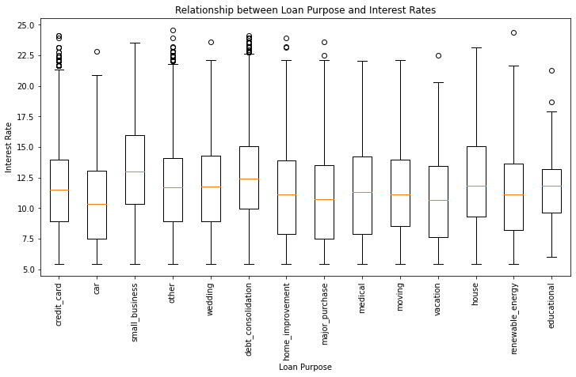
7.Relationship between Loan Purpose and Interest Rates
The observed data indicates that the relationship between loan purpose and interest rates is not straightforward. Loans for purposes such as home mortgages, which typically have longer durations, tend to be associated with higher interest rates. Conversely, smaller business loans may also command higher rates due to increased risk. This complex interplay suggests that loan duration and risk factors play significant roles in determining interest rates.

Slide 9
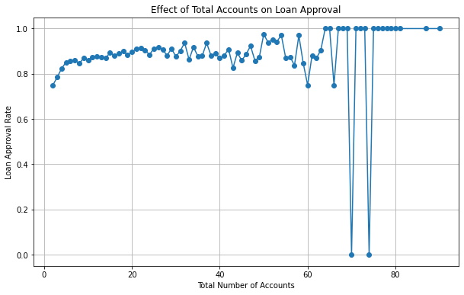
8.Effect of Total Accounts on Loan Approval
Based on the observation, there is no significant correlation between the number of total accounts and loan approval. It appears that loan approval is not contingent on the quantity of accounts, suggesting that other factors or criteria play a more substantial role in determining whether a loan application is accepted or rejected.

Slide 10
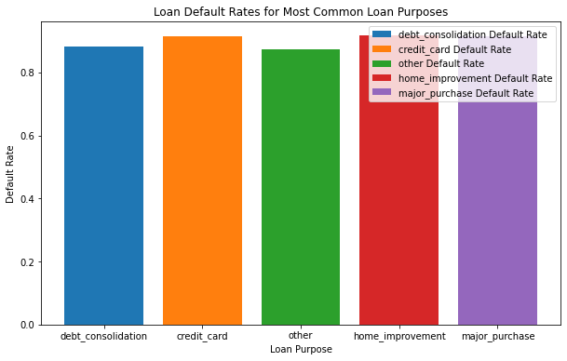
9.Analyzing the Relationship Between Loan Purposes and Loan Default Rates
An analysis of the relationship between loan purposes and loan default rates revealed a noteworthy trend. Loans allocated for home-related expenses and credit card utilization consistently exhibited higher default rates. This observation underscores the need for a closer examination of the factors contributing to increased default risk in these specific loan categories, possibly prompting lenders to adapt their risk assessment and lending strategies accordingly.

Slide 11
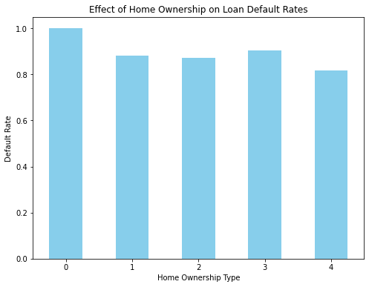
10.How does the type of home ownership influence loan default rates
The analysis reveals that the type of home ownership significantly impacts loan default rates. Particularly, homes categorized as "RENT" (with a code of 2) and "MORTGAGE" (with a code of 3) show notably higher default rates. This association suggests that individuals residing in rented or mortgaged homes are more susceptible to loan defaults, possibly due to increased financial commitments. Further exploration of this trend is warranted to develop targeted strategies for risk mitigation in these specific homeownership categories, especially when coupled with high

